Slide 1
Johnson Liu

Slide 2
2025 EOY Bonus

Slide 3
Bonus
Bonus Depends on company results & your results
2025 sales were down vs. 2024 and vs. our target.
However, we did a better job of managing our costs and improved our profitability.
Flyers can receive up to 100% of their bonus.
Your 2025 Bonus Potential
RMB 1,037 7 Months
Your 2025 Actual Bonus
RMB 2,069 0 Months 7% of Potential

Slide 4
2026

Slide 5
2026 Salary
Current Salary
RMB 3,036 Per month
2026 Salary
RMB 4,008 Per month
Merit Increase %
7 %
2026 Bonus Potential
RMB 5,047 6 Months

Slide 6
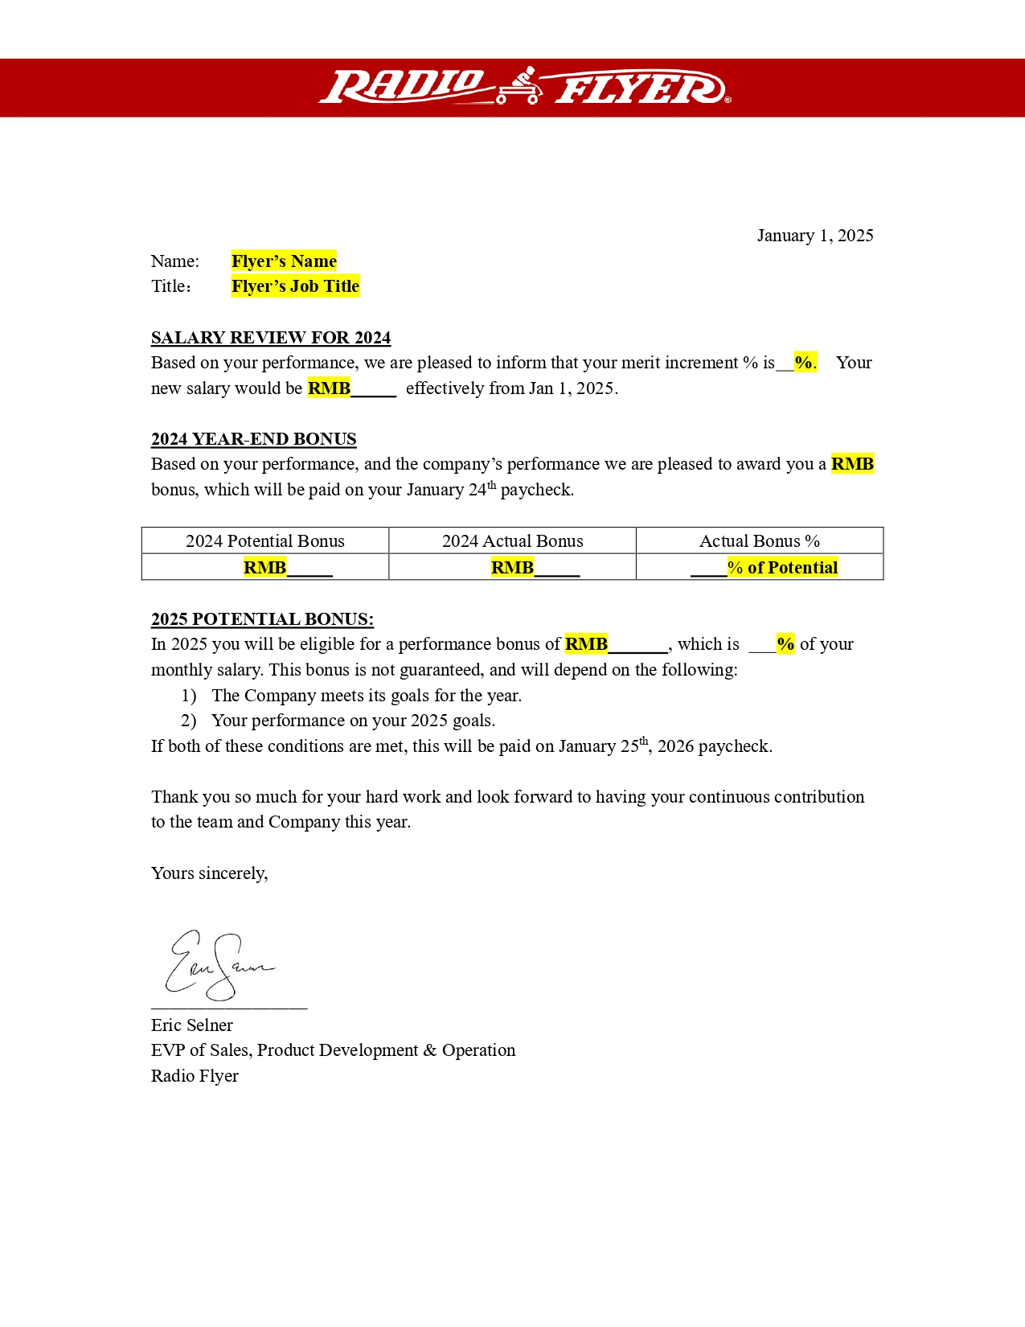
Image: Flyer’s salary letter

Slide 8
Allen Yan

Slide 9
2025 EOY Bonus

Slide 10
Bonus
Bonus Depends on company results & your results
2025 sales were down vs. 2024 and vs. our target.
However, we did a better job of managing our costs and improved our profitability.
Flyers can receive up to 100% of their bonus.
Your 2025 Bonus Potential
RMB 1,084 6 Months
Your 2025 Actual Bonus
RMB 2,090 4 Months 6% of Potential

Slide 11
2026

Slide 12
2026 Salary
Current Salary
RMB 3,007 Per month
2026 Salary
RMB 4,081 Per month
Merit Increase %
7 %
2026 Bonus Potential
RMB 5,023 5 Months

Slide 13
Image: Flyer’s salary letter

Slide 15
Johnson Zhang

Slide 16
2025 EOY Bonus

Slide 17
Bonus
Bonus Depends on company results & your results
2025 sales were down vs. 2024 and vs. our target.
However, we did a better job of managing our costs and improved our profitability.
Flyers can receive up to 100% of their bonus.
Your 2025 Bonus Potential
RMB 1,085 7 Months
Your 2025 Actual Bonus
RMB 2,033 2 Months 1% of Potential

Slide 18
2026

Slide 19
2026 Salary
Current Salary
RMB 3,014 Per month
2026 Salary
RMB 4,058 Per month
Merit Increase %
8 %
2026 Bonus Potential
RMB 5,086 7 Months

Slide 20
Image: Flyer’s salary letter

Slide 22
Terry Ou

Slide 23
2025 EOY Bonus

Slide 24
Bonus
Bonus Depends on company results & your results
2025 sales were down vs. 2024 and vs. our target.
However, we did a better job of managing our costs and improved our profitability.
Flyers can receive up to 100% of their bonus.
Your 2025 Bonus Potential
RMB 1,030 3 Months
Your 2025 Actual Bonus
RMB 2,020 2 Months 4% of Potential

Slide 25
2026

Slide 26
2026 Salary
Current Salary
RMB 3,066 Per month
2026 Salary
RMB 4,049 Per month
Merit Increase %
5 %
2026 Bonus Potential
RMB 5,025 0 Months

Slide 27
Image: Flyer’s salary letter

Slide 29
Kent Xia

Slide 30
2025 EOY Bonus

Slide 31
Bonus
Bonus Depends on company results & your results
2025 sales were down vs. 2024 and vs. our target.
However, we did a better job of managing our costs and improved our profitability.
Flyers can receive up to 100% of their bonus.
Your 2025 Bonus Potential
RMB 1,057 3 Months
Your 2025 Actual Bonus
RMB 2,073 8 Months 4% of Potential

Slide 32
2026

Slide 33
2026 Salary
Current Salary
RMB 3,040 Per month
2026 Salary
RMB 4,092 Per month
Merit Increase %
3 %
2026 Bonus Potential
RMB 5,069 6 Months

Slide 34
Image: Flyer’s salary letter

Slide 36
Danny Ren

Slide 37
2025 EOY Bonus

Slide 38
Bonus
Bonus Depends on company results & your results
2025 sales were down vs. 2024 and vs. our target.
However, we did a better job of managing our costs and improved our profitability.
Flyers can receive up to 100% of their bonus.
Your 2025 Bonus Potential
RMB 1,019 5 Months
Your 2025 Actual Bonus
RMB 2,007 4 Months 9% of Potential

Slide 39
2026

Slide 40
2026 Salary
Current Salary
RMB 3,037 Per month
2026 Salary
RMB 4,048 Per month
Merit Increase %
4 %
2026 Bonus Potential
RMB 5,029 9 Months

Slide 41
Image: Flyer’s salary letter

Slide 43
Jack liang

Slide 44
2025 EOY Bonus

Slide 45
Bonus
Bonus Depends on company results & your results
2025 sales were down vs. 2024 and vs. our target.
However, we did a better job of managing our costs and improved our profitability.
Flyers can receive up to 100% of their bonus.
Your 2025 Bonus Potential
RMB 1,069 2 Months
Your 2025 Actual Bonus
RMB 2,038 8 Months 3% of Potential

Slide 46
2026

Slide 47
2026 Salary
Current Salary
RMB 3,065 Per month
2026 Salary
RMB 4,098 Per month
Merit Increase %
8 %
2026 Bonus Potential
RMB 5,047 2 Months

Slide 48
Image: Flyer’s salary letter

Slide 50
Rio Li

Slide 51
2025 EOY Bonus

Slide 52
Bonus
Bonus Depends on company results & your results
2025 sales were down vs. 2024 and vs. our target.
However, we did a better job of managing our costs and improved our profitability.
Flyers can receive up to 100% of their bonus.
Your 2025 Bonus Potential
RMB 1,001 1 Months
Your 2025 Actual Bonus
RMB 2,064 0 Months 2% of Potential

Slide 53
2026

Slide 54
2026 Salary
Current Salary
RMB 3,005 Per month
2026 Salary
RMB 4,014 Per month
Merit Increase %
0 %
2026 Bonus Potential
RMB 5,073 0 Months

Slide 55
Image: Flyer’s salary letter

Slide 57
Lay Peng

Slide 58
2025 EOY Bonus

Slide 59
Bonus
Bonus Depends on company results & your results
2025 sales were down vs. 2024 and vs. our target.
However, we did a better job of managing our costs and improved our profitability.
Flyers can receive up to 100% of their bonus.
Your 2025 Bonus Potential
RMB 1,030 4 Months
Your 2025 Actual Bonus
RMB 2,009 0 Months 3% of Potential

Slide 60
2026

Slide 61
2026 Salary
Current Salary
RMB 3,077 Per month
2026 Salary
RMB 4,009 Per month
Merit Increase %
9 %
2026 Bonus Potential
RMB 5,017 0 Months

Slide 62
Image: Flyer’s salary letter

